Slide 1
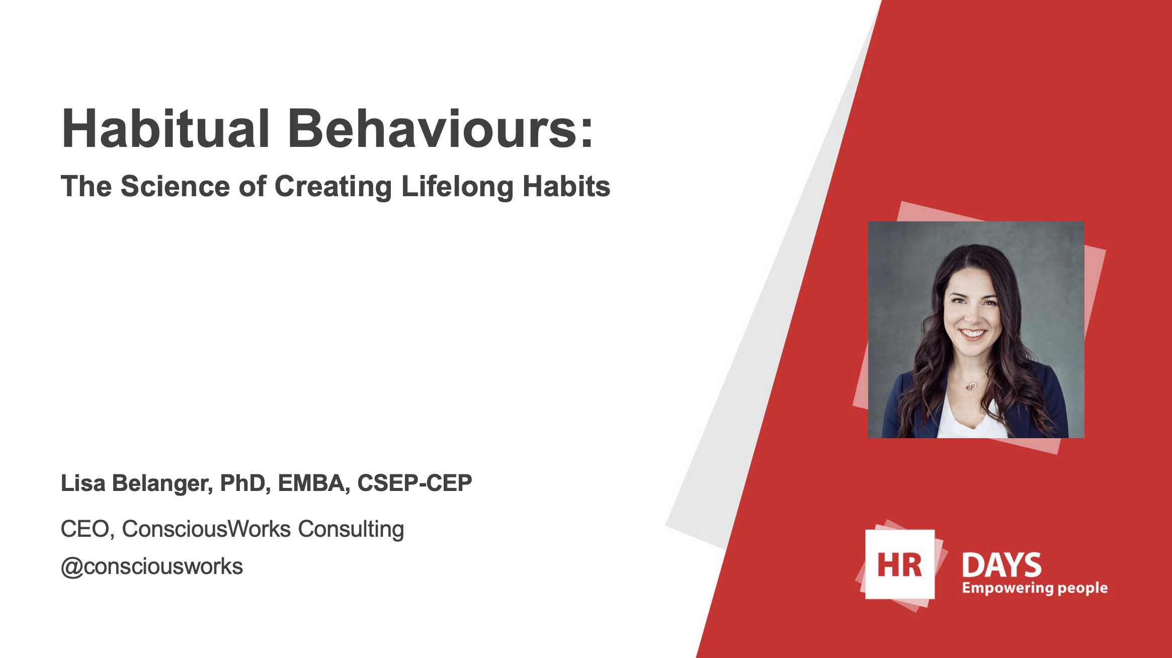

Slide 2


Slide 3
Physical Activity
Nutrition
Sleep
Stress

Slide 4
Affective Attitude
Fun
Instrumental Attitude
Important
Descriptive Norm
My people do it
Injunctive Norm
My people support it
Perceived Behavioural Control
I believe I can do it
Intention
Planning
Behaviour
THEORY OF PLANNED BEHAVIOUR
Adapted from Ajzen, Icek (1991). "The theory of planned behavior". Organizational Behavior and Human Decision Processes. 50 (2):
179–211. doi:10.1016/0749-5978(91)90020-T

Slide 5


Slide 6
Opportunity

Slide 7
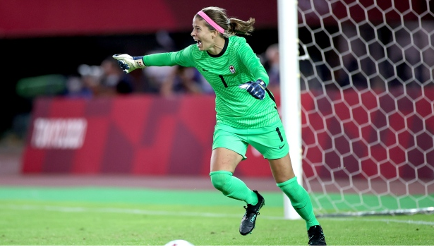


Slide 8


Slide 9


Slide 10
Motive

Slide 11

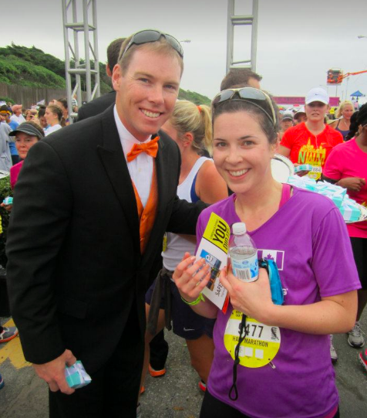

Slide 12
Collaboration is the new competition.

Slide 13


Slide 14
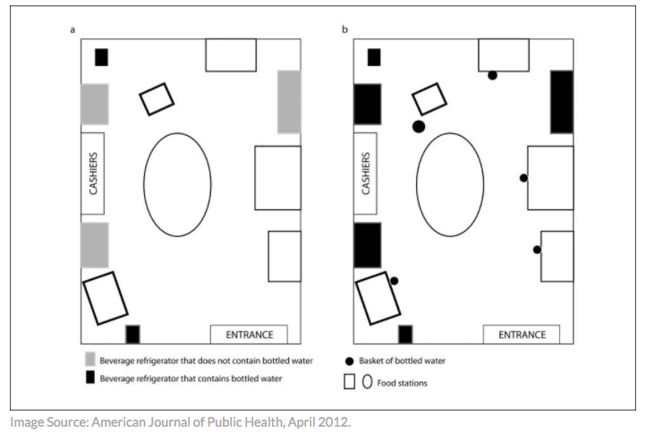

Slide 15
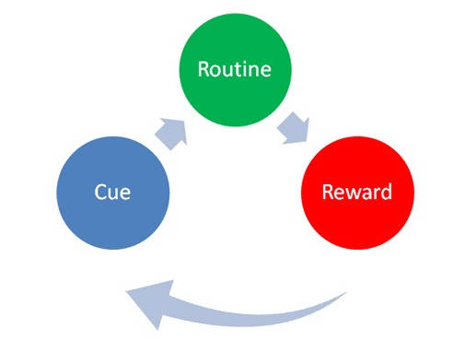

Slide 16


Slide 17
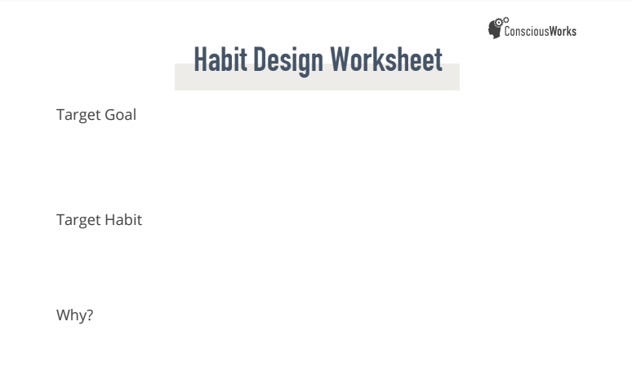

Slide 18
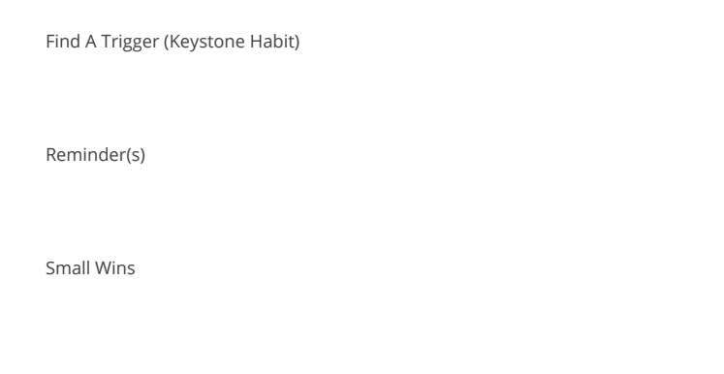

Slide 19
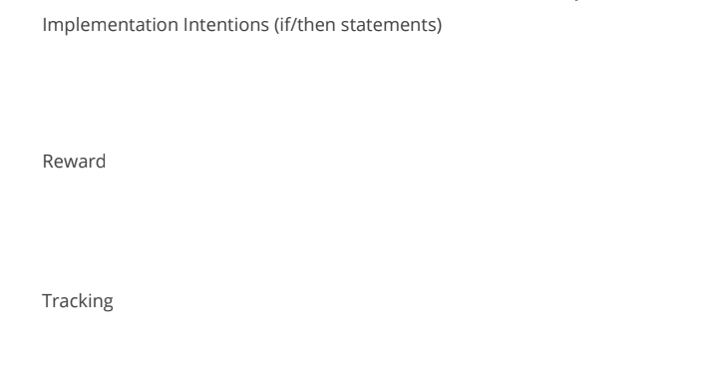

Slide 20
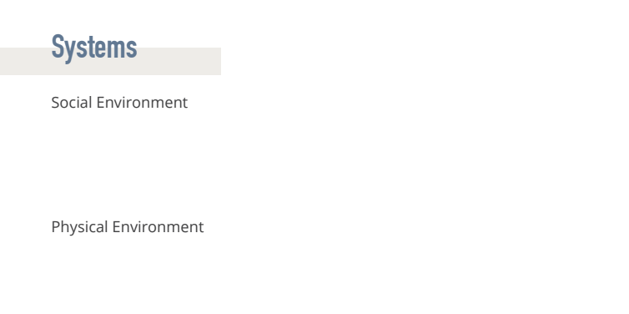

Slide 21
Thank you!
lisa@consciousworks.com
@consciousworks
www.consciousworks.com

